Slide 1
Effects of Beta and Delta/Theta Binaural Beats on Stroop Test
Research Project for Research Methodologies in Humanities and Science and Cognitive Science & Psychology
Carles Tardío, Borja Sabio, Selin Akcakaya, Xavier Duran, María Blancas

Slide 2
Background
- When two pure tones of slightly different frequency are presented separately to each ear, the listener perceives a third single tone with amplitude variations at a frequency that equals the difference between the two tones, this perceptual illusion is known as binaural auditory beat (Oster, 1973).
- There are anecdotal reports that suggest that the binaural beat can entrain EEG activity (Jan Schnupp, 2011) and may affect the arousal levels, although few studies have been published (Tina L.Huang, C.Charyton, 2008),(D.S.Foster,1990). Few studies explore how BB’s affect performance on attention tasks (Lane et al, 1998),(Wahbeh et al, 2008),(Crespo et al, 2012).
- There is a need for double-blind, well-designed studies in order to establish a solid foundation for these sounds, as most of the documented benefits come from self-reported cases that could be affected by placebo effect and also from authors related to commercial companies (Charyton, 2008).

Slide 3
Experimental Study
- The aim in our research was to explore the potential of BB’s in a particular field: tasks that require focus and concentration (Stroop Effect).
- In this study we compare the effect of different binaural stimulation in delta/theta and beta frequency ranges, 20 participants were exposed to ~15 min + ~15 min binaural beat stimulation.
-Hypothesis: “Exposure to binaural auditory beats in the EEG beta frequency ranges in comparison to delta/theta frequency ranges improves significantly performance in stroop test.”
- The effects were obtained with qualitative stroop application. Results suggest no significant statistical improvement in 15 min stimulation.

Slide 4
Methods - Materials & equipment
- Sound Room (La Nau): soundproof
- Stereo Headphones and microphone
- Binaural beats (double blinded):
- Delta/theta: at 1.5 Hz and 4 Hz + pink noise as background
- Beta: at 16 Hz and 24 Hz + pink noise as background
Subject perception: BB non perceptible, 2 sounds alike
- iPad

Slide 5
Methods - Experiment design
- Within subjects.
- 21 participants (1 removed): 11 male, 9 female. Mean age 28.1 years old.
- Counterbalance: Randomized sound sequence: 10 AB, 10 BA.

Slide 6
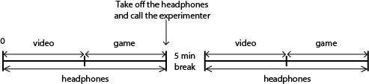
Methods - Procedures
Experiment:
- Part I
Ishihara Test (9’)
- Part II
Stroop Test (~ 6’ depending on performance)
Notes:
The experiment was performed in an iPad and the duration of the entire procedure was 35 minutes.
It consisted in two parts, each of them lasted 15 minutes and there was a break of five minutes between them. Each part had two subparts.
The subject was told to wear headphones during the whole experiment in order to block noise from the exterior and the importance of not removing them before the end of the game.
The first subpart lasted nine minutes and it consisted in a video with Ishihara color test plates. In it, the subject was presented a set of images displaying numbers and shapes in coloured backgrounds; and he was requested to identify the number, line or shape that he/she could see in each slide and report it through the microphone.
The second subpart lasted about six minutes (depending on the subject’s performing) and it is was centered in the Stroop test. The subject had to perform a color detection game in the iPad. He/she was shown the game before the experiment began. When the video stopped, the subject had to start the game and had to take off the headphones and report it to the examiners when the game finished.
The Ishihara test, introduced in 1917, consists in different plates with figures or patterns constituted of colored dots of diverging size that the subjects are asked to recognize among differently colored dots that surround these figures or patterns.
The video was composed by 17 number plates, 6 shapes plates and 9 lines plates. All the slides lasted 15 seconds.

Slide 7
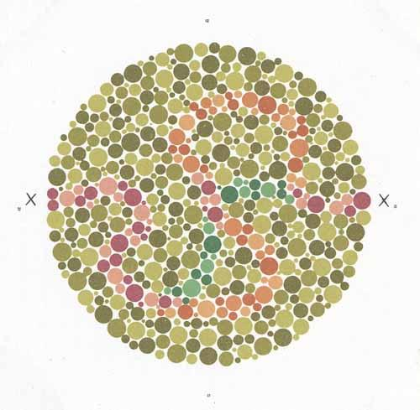
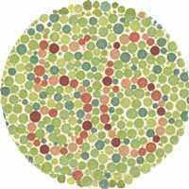
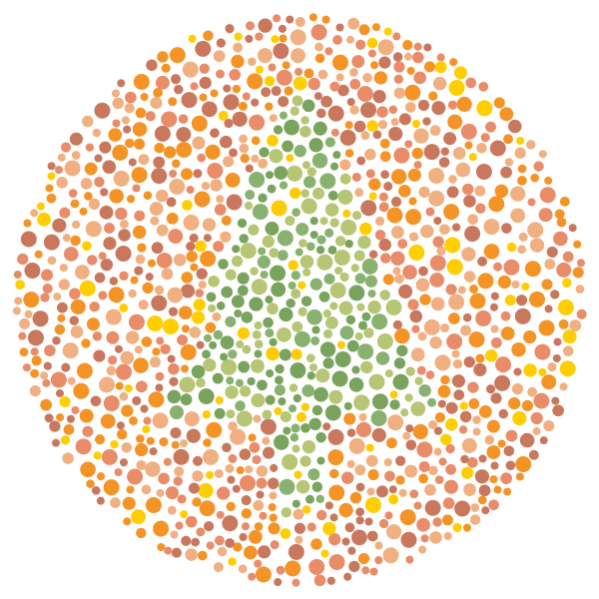
Methods - Procedures - Part I
Ishihara test
17 numbers plates 6 shapes plates 9 lines plates
Notes:
The first subpart lasted nine minutes and it consisted in a video with Ishihara color test plates. In it, the subject was presented a set of images displaying numbers and shapes in coloured backgrounds; and he was requested to identify the number, line or shape that he/she could see in each slide and report it through the microphone.
The Ishihara test, introduced in 1917, consists in different plates with figures or patterns constituted of colored dots of diverging size that the subjects are asked to recognize among differently colored dots that surround these figures or patterns.
The video was composed by 17 number plates, 6 shapes plates and 9 lines plates. All the slides lasted 15 seconds.

Slide 8
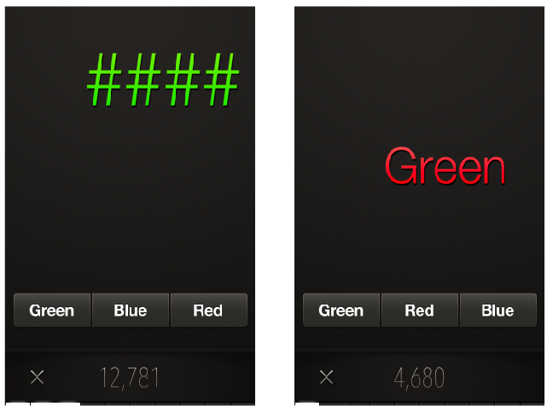
Methods - Procedures - Stroop Test App
App for research purposes
(screen for Minimal Hepatic
Encephalopathy. Bajaj et al., 2013)
Stroop Off and
Stroop On State

Slide 9
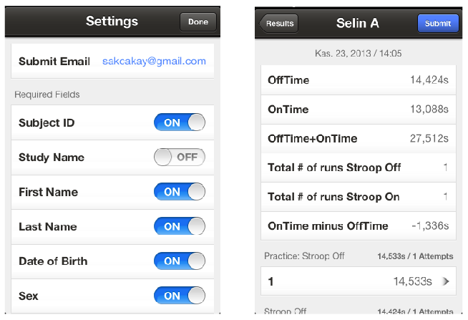
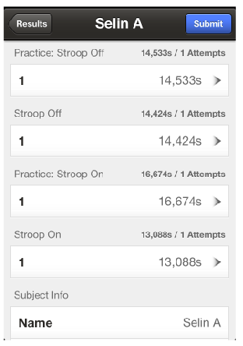
Methods - Procedures - Stroop Test App
Settings and Results of Application

Slide 10
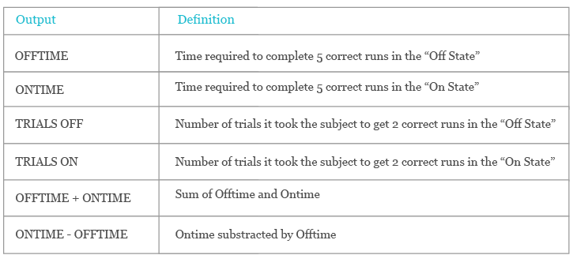
Methods - Procedures - Stroop Test App
Stroop Output
Notes:
1-Psychomotor speed 2- Psychomotor speed and cognitive flexibility 3-Accuracy 4-Accuracy and flexibility 5-Composite of psychomotor speed
6-Isolated measure of cognitive flexibility

Slide 11
Results
- Two-way repeated measures ANOVA
- Mean reaction time for a single item
- Factors:
- Stroop level (neutral, incongruent)
- Binaural beat frequencies (beta, delta/theta)

Slide 12
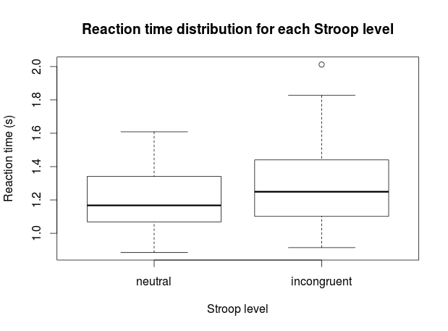
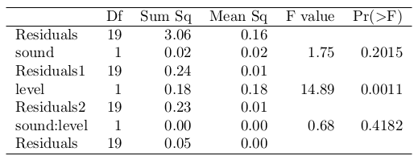
Results (mean reaction time)
- Neutral (off)
M=1.20, SD=0.18
- Incongruent (on)
M=1.29, SD=0.25
ANOVA

Slide 13
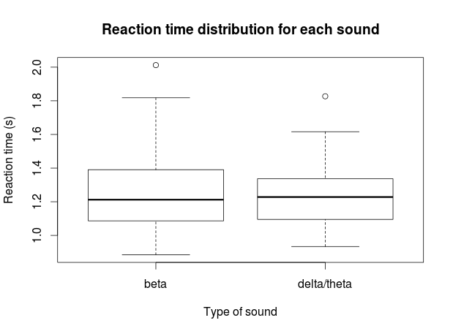
Results (mean reaction time)
- Beta
M=1.26, SD=0.24
- Delta/Theta
M=1.23, SD=0.20
ANOVA

Slide 14
Results
- Accuracy (%)
- 100*(5+5)/(TRIALS OFF+TRIALS ON)
- Total time
- OFFTIME+ONTIME

Slide 15
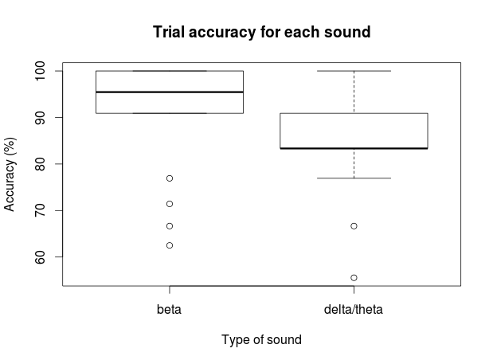
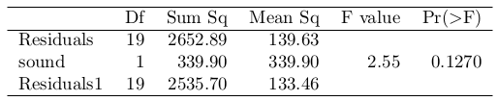
Results (accuracy)
- Beta
M=91.15, SD=12.13
- Delta/Theta
M=85.32, SD=11.22
ANOVA

Slide 16
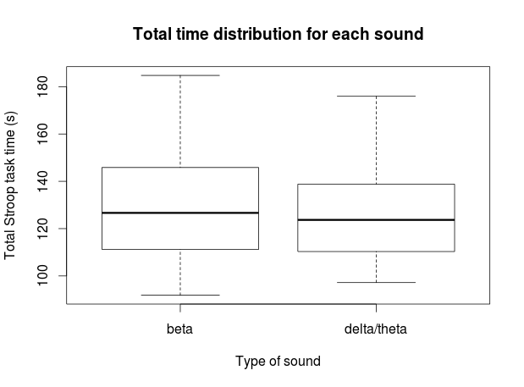
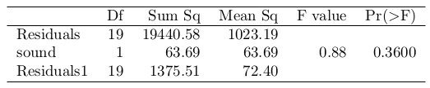
Results (total time)
- Beta
M=130.58, SD=25.21
- Delta/Theta
M=128.05, SD=21.44
ANOVA

Slide 17
Discussion
Hypothesis: “Exposure to binaural auditory beats in the EEG beta frequency ranges in comparison to delta/theta frequency ranges improves significantly performance in stroop test”
Conclusion:
• No statistically significant difference found between the two conditions (p>0.05)
• Results provide no evidence for improvements in cognitive function after exposure to beta binaural beats (mean time 15’ 09”) in contrast to theta/delta binaural beats (mean time 15’ 03”) in a small sample of 20 healthy adults.
• Stroop effect was observed

Slide 18
Discussion
Limitations:
•Experiment duration may not be sufficient for entrainment
Improvements:
•Increase exposure time to BB
•Sessions in separate days
•More sessions
•Increase sample size
•Within subjects vs between groups
+ avoid learning curve
- natural variance (big sample needed)

Slide 19
References
[1] G. Oster, “Auditory beats in the brain,” Scientific American, vol. 229, no. 4, pp. 94–102, 1973.
[2] Tina L.Huang, C.Charyton, Alternative Therapies, sep/oct 2008, VOL. 14, NO. 5 Psychological Effects of Brainwave Entrainment
[3] D. S. Foster, “EEG and Subjective Correlates of Alpha-Frequency Binaural-Beat Stimulation
Combined with Alpha Biofeedback,” pp. 1–34, 1990.
[4] J. D. Lane, S. J. Kasian, J. E. Owens, and G. R. Marsh, “Binaural Auditory Beats Affect
Vigilance Performance and Mood,” Physiology & Behavior, vol. 63, no. 2, pp. 249–252, 1998.
[5] Helané Wahbeh, Carlo Calabrese, Heather Zwickey, and Dan Zajdel. The Journal of Alternative and Complementary Medicine. March 2007, 13(2): 199-206. doi:10.1089/acm.2006.6201.
[6] Crespo Pelayo, Adela del Carmen and Recuero López, Manuel and Gálvez García, Gerardo Miguel and Begoña Monco, Adrián (2012) Effects of binaural stimulation in attention and EEG. In: VIII Congresso Ibero-americano de Acústica, 01/10/2012 - 03/10/2012, Évora (Portugal).
[7] Bajaj, J. S., Thacker, L. R., Heuman, D. M., Fuchs, M., Sterling, R. K., Sanyal, A. J., … Wade, J. B. (2013). The Stroop smartphone application is a short and valid method to screen for minimal hepatic encephalopathy. Hepatology (Baltimore, Md.), 58(3), 1122–32. doi:10.1002/hep.26309
[8] Charyton, C. (2008). A comprehensive review of the psychological effects of the psychological effects of brainwave entrainment, 14(5).
[9] Jan Schnupp, Israel Nelken and Andrew King (2011). Auditory Neuroscience. MIT Press

